Slide 1
Pharmacy Record Management System
FYP Documentation

Slide 2
Introduction
The Pharmacy record management system is the system used for medicine stock inventory in the pharmacy. This system enables the manager of the pharmacy to record and manage all activities of the pharmacy. The Pharmacy Record Management System is a comprehensive software solution designed to streamline and automate the management of records within a pharmacy setting. It aims to enhance efficiency, accuracy, and security in handling various pharmacy-related records such as prescriptions, medication inventory and billing.
It is accessible either to administrator. Only administration can add data into the database. This system also enables the workforce of the pharmacy to offer their services in a manner which is more efficient and systematic which also improve of the pharmacy. The pharmacy record management software enables to maintain the details of purchase stock by the pharmacy and the details of the selling stock by customer wise. The pharmacy record management software enables to maintain the details of purchase stock by the pharmacy and the details of the selling stock by customer wise.

Slide 3
Background of the System
The current manual system has a lot of paper work to do. To maintain the records of sale and services manually, is a time-consuming task. With the increase in information, it will become a huge task to maintain the database. Requires large quantities of the file’s cabinets, which are huge and requires a lot of space in the office, which can be used for storing the previous details. The retrieval of previous records will be tiring. Lack of security for the records of Pharmacy Management System. If anyone wants to check the previous records there will be inadequate information available.
The Pharmacy Management system is computerized management system designed for any Pharmacy to replace the existing manual system. The new system will maintain the data of Customer, Salesman and Admin. These services are to be provided to be in efficient, cost-effective manner, with the goal of reducing the time and currently required for such tasks. It is simple, fast and user-friendly. It reduces the paper work. This project is GUI based that will help in storing, updating and retrieving the information through various user-friendly menu-drives modules. The system's reporting and analytics capabilities enable pharmacies to gain insights into medication trends, optimize inventory management, and identify cost-saving opportunities.

Slide 4
Objectives
The main objective of this project is to develop a Desktop Application that will simplify
It will help to look for the customer details and manage it.
It also maintains the medicine information such as the available in pharmacy.
It can also provide the admin to store the report in the database and make it available to the customer.
We give a admin name and password of Desktop Application to maintain the records.
Capture, store and maintain customer, supplier and product records.
To reduce paper work and cost associated.
The system prioritizes data security and confidentiality by implementing stringent security measures, including user authentication, data encryption, and access controls.

Slide 5
Product Scope And Requirement
Scope:
The system will be used as the Desktop application that serves the Pharmacy System. The intention of the system is to increase the number of customers that can be managed efficiently. Bills are generated by recording price for each medicine price provided by Admin. The Pharmacy management is file-based management of the system has to put much effort on securing the files before that system. They can be easily damaged by fire, insects, and natural disasters. Also, could be misplaced by losing data and information. Now by using that system they store record in database and create backup.

Slide 6
Specific Requirements

Slide 7
Functional Requirements
There will be following Requirements of this application:
Admin Login
User friendly interfaces
Interfaces validation check for entry, update, delete, search etc.
Medicine(s) record entry, update, delete
Track all information of medicine(s), inventory, pharmacy
Shows information and descriptions of pharmacy, stocks
Bill calculation.
Record updating in case medicine(s) sold, returned
Total Cost of all medicines
Calculate total profit
Deduct amount from total sales if the customer returns medicine(s)

Slide 8
Cont……
Updating quantities of medicine(s) in case of populating pharmacy with medicines.
Report generation
Show the list of short items
Show the brand name with medicine name

Slide 9
Non functional requirements
Performance Requirements
Response Time: The system provides acknowledgment in just one and half second when the admin is searching the information about medicine.
Capacity: The system needs to support at least one person at a time.
User-Interfaces: The user interfaces knowledges within five seconds.

Slide 10
Cont…
Software Quality Attributes
Maintainability
Back-up: The system is efficient for data backup.
Errors: The system will track every mistake as well as keep log of it.
Availability: The system is available for all the time but the access level is controlled for each user.
Safety and Security Requirements
Administration: The administration can view as well as alter any information in the system.
Login ID: Any admin who wants to use the system needs to hold on Login ID and password.

Slide 11
Cont……
Useability
Ease-of-use requirements address the factors that constitute the capacity of the software to be understood, learned, and used by its intended users.
Efficiency
Specifies how well the software utilizes scarce resources: CPU cycles, disk space, memory, bandwidth, etc.
Availability
The system is available for all the time but the access level is controlled for each Admin.

Slide 12
DESIGN SPECIFICATIONS

Slide 13
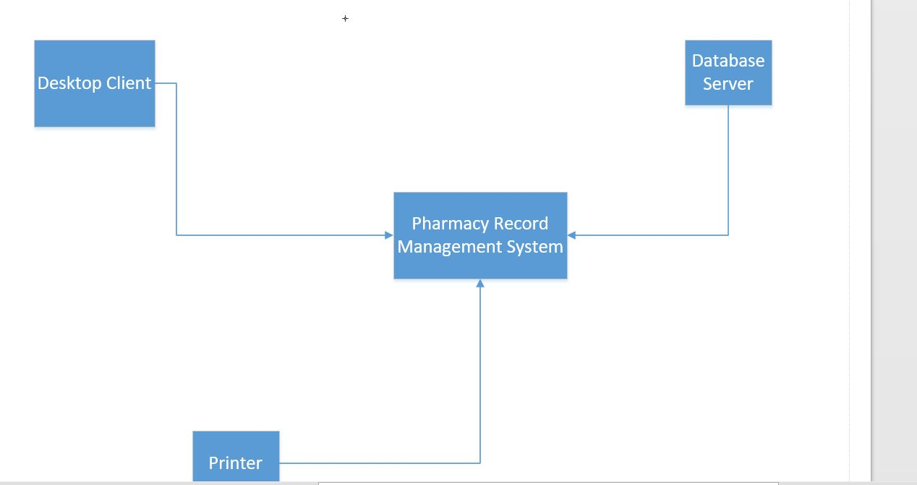
deployment Diagram

Slide 14
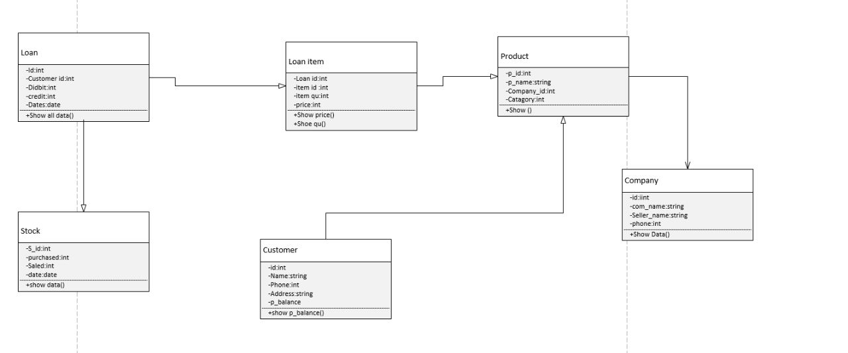
Class Diagram

Slide 15
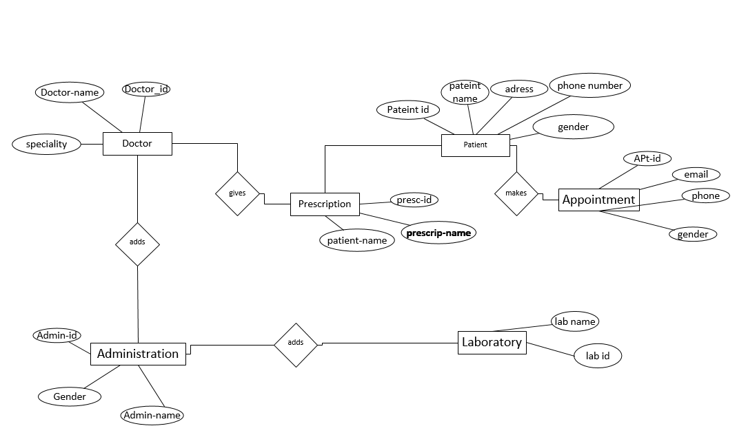
Er Diagram

Slide 16
DEVELOPMENT AND TOOLS

Slide 17
Development Tools
Tools And Technologies | Tools |  | Version | Rationale
 | Visual studio |  | 2015 | IDE
 | MS Word |  | 2019 | Documentation
 | Power Point |  | 2019 | Presentation
 | Sql server |  | 2015 | Database
 | .net |  |  | Framework
 | C# |  | 5 | For Coding

Slide 18
User Manual

Slide 19
User manual
User manual consist of hardware and software requirements of our system .
Login Page
Dashboard
Order
Product
Customer
Company
Loan
Stock
Logout

Slide 20
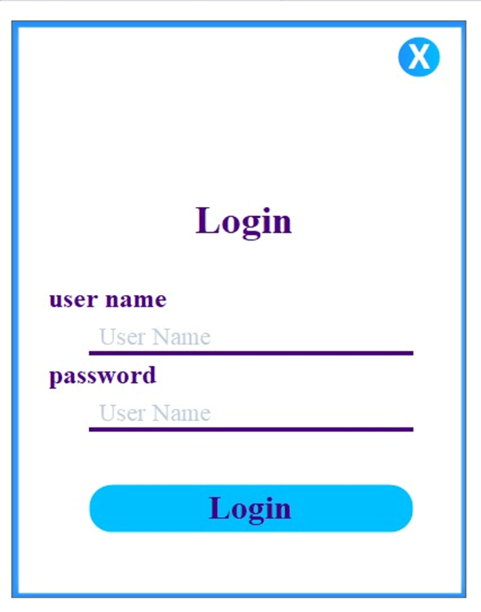
Interfaces of project

Slide 21
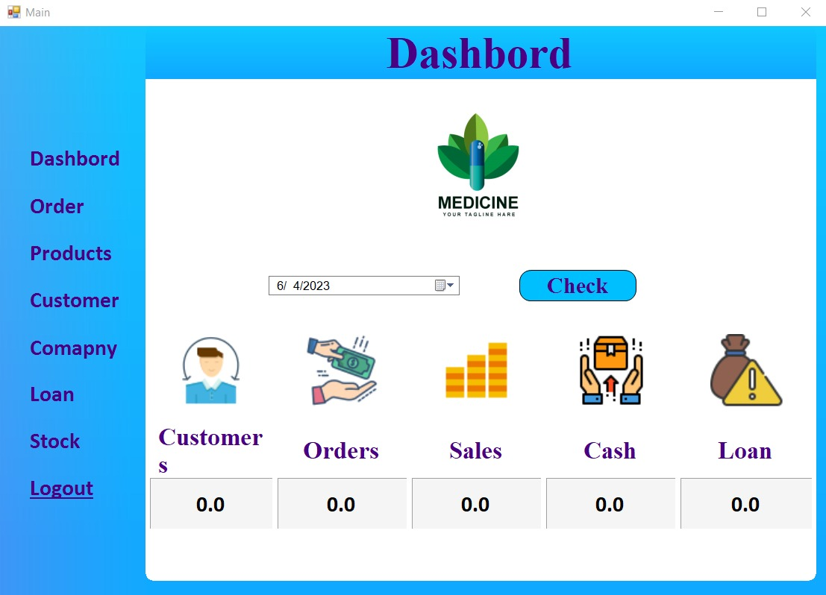
Dashbord

Slide 22
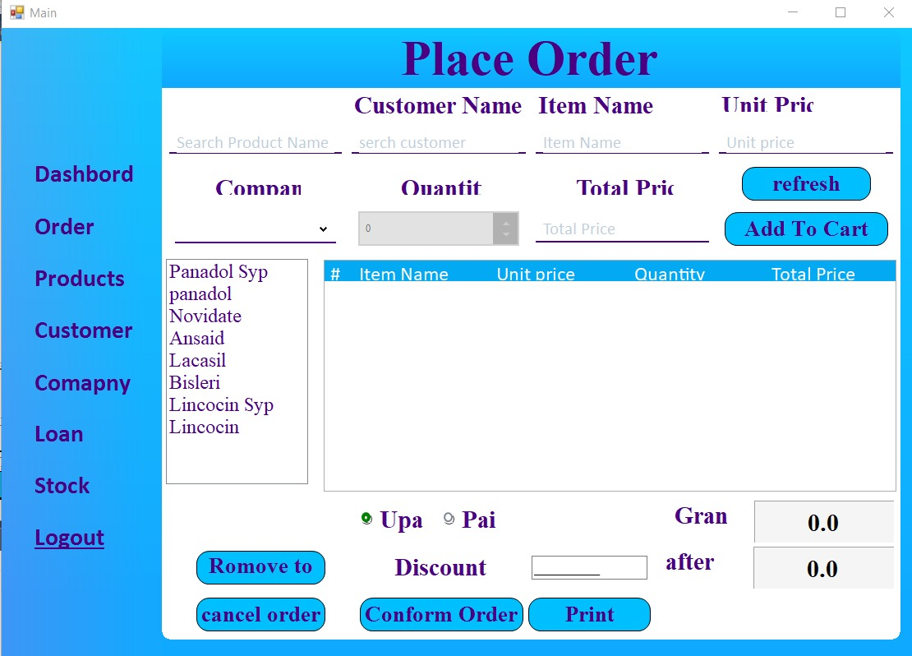
Order

Slide 23
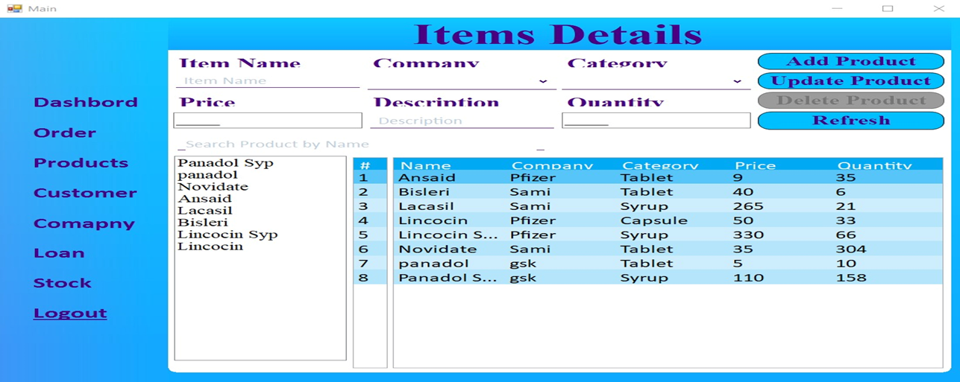
Products

Slide 24
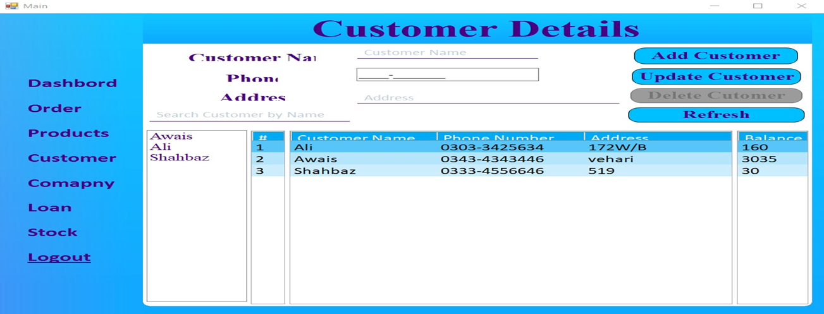
Customer

Slide 25
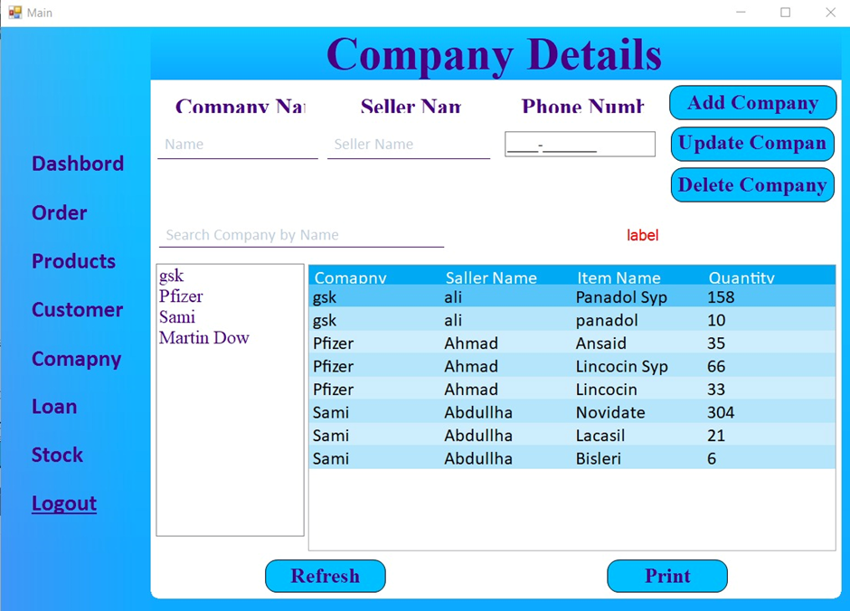
Company

Slide 26
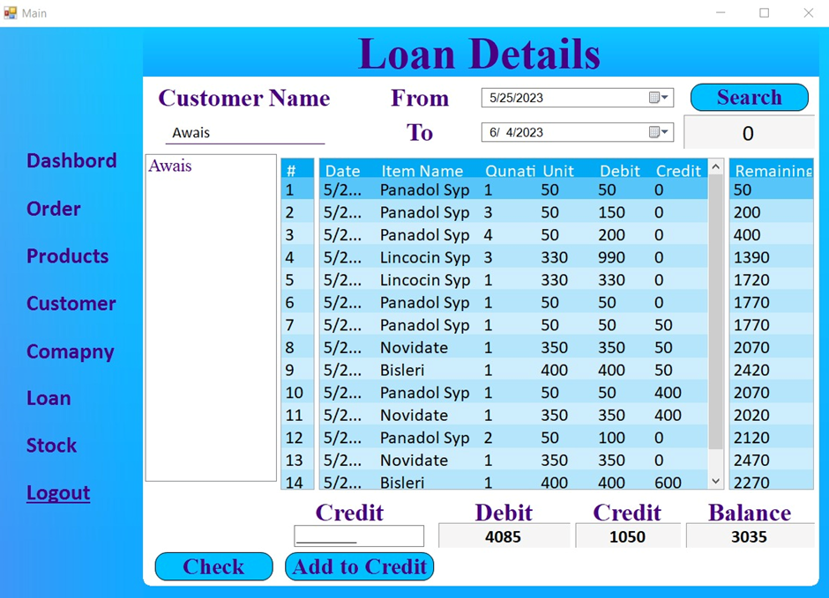
Loan

Slide 27
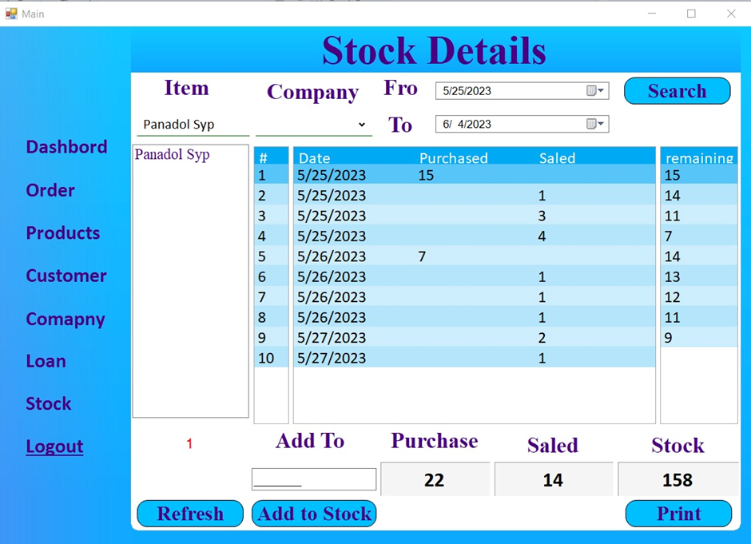
Stock

Slide 28
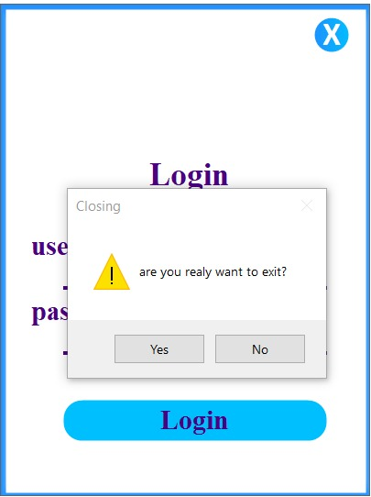
Logout

Slide 29
Thank you for checking upon us!
Members name:
Muhammad Shahbaz(CIIT/FA19-BSE-003/VHR)
Muhammad Awis Qurne (CIIT/FA19-BSE-005/VHR)
Supervisor BY:
Mr. Nahit Ali

